Slide 1
Data binding
https://learn.microsoft.com/en-us/windows/apps/develop/data-binding/data-binding-overview

Slide 2
Main content
Basic Data binding
Converter
INotifyPropertyChanged
List data binding: ComboBox, ListView

Slide 3
Basic Data binding

Slide 4
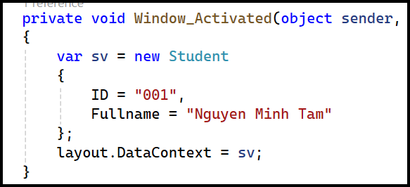
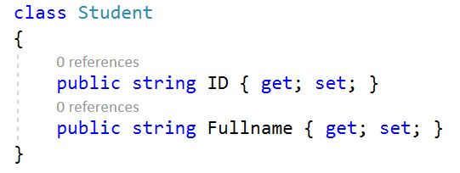
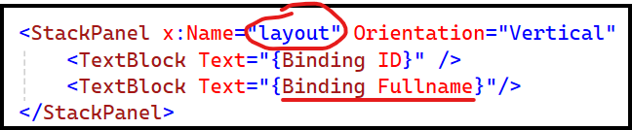

Old way: DataContext & Binding

Slide 5
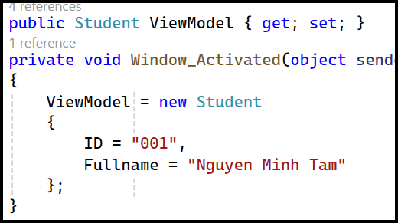
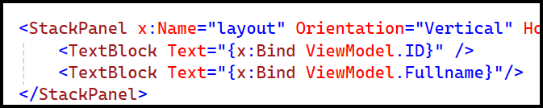
New way: x:Bind

Slide 6
Binding vs x:Bind
Binding: any type, runtime
x:Bind: type strict, compile

Slide 7
Converter

Slide 8
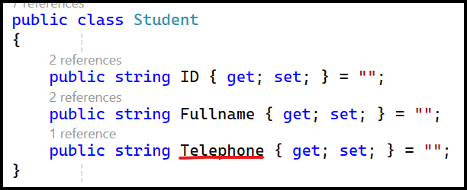

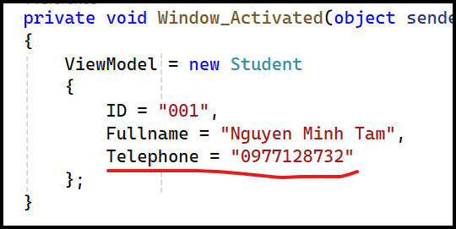
Expected result

Slide 9
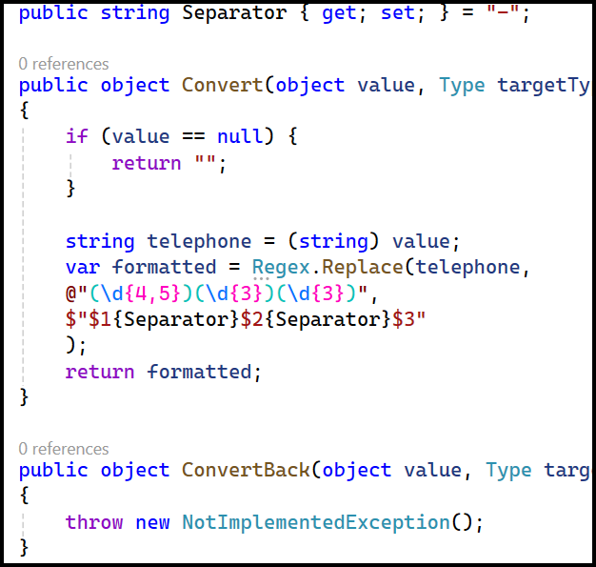
Converter – Step 1 - StringToTelephoneConverter

Slide 10
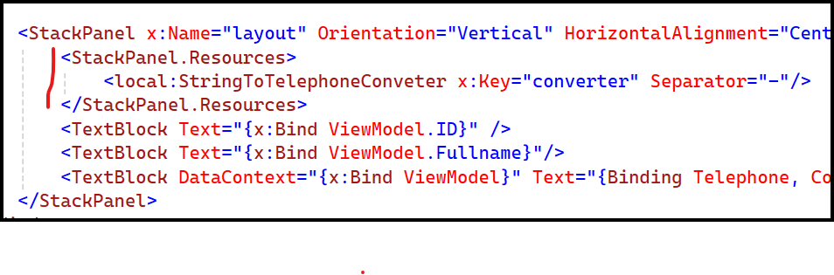
Step 2: Declaration as a resource
var converter = new StringToTelephoneConverter();

Slide 11
Step 3: Use the Converter

Slide 12
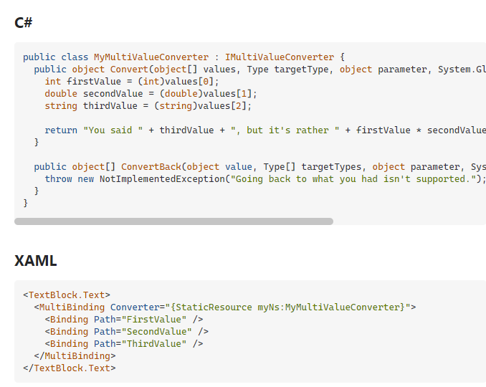
Multi value converter

Slide 13
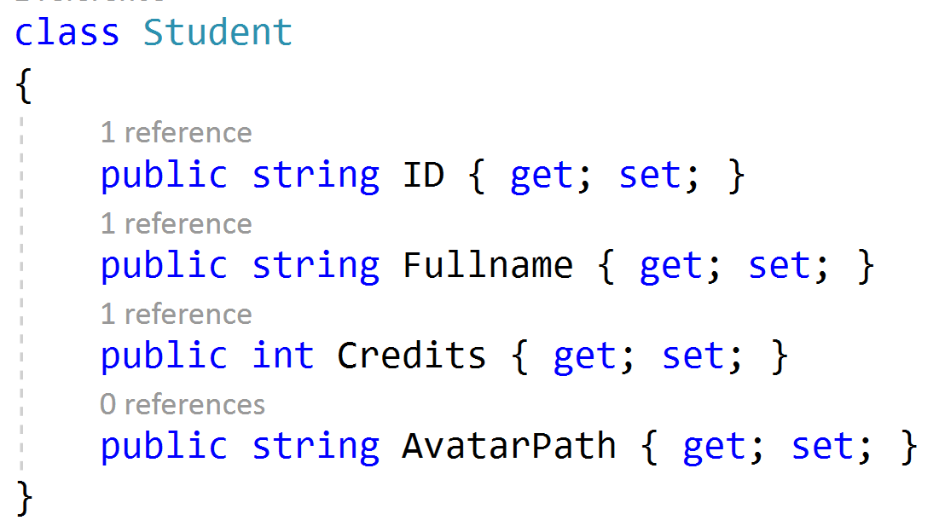
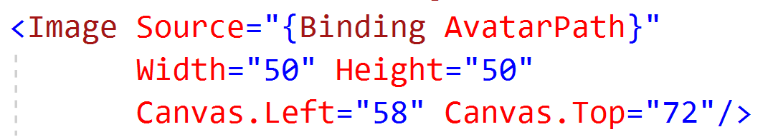
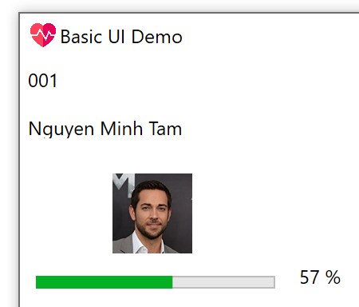
Displaying image using data binding
Using embeded image inside the executable file

Slide 14
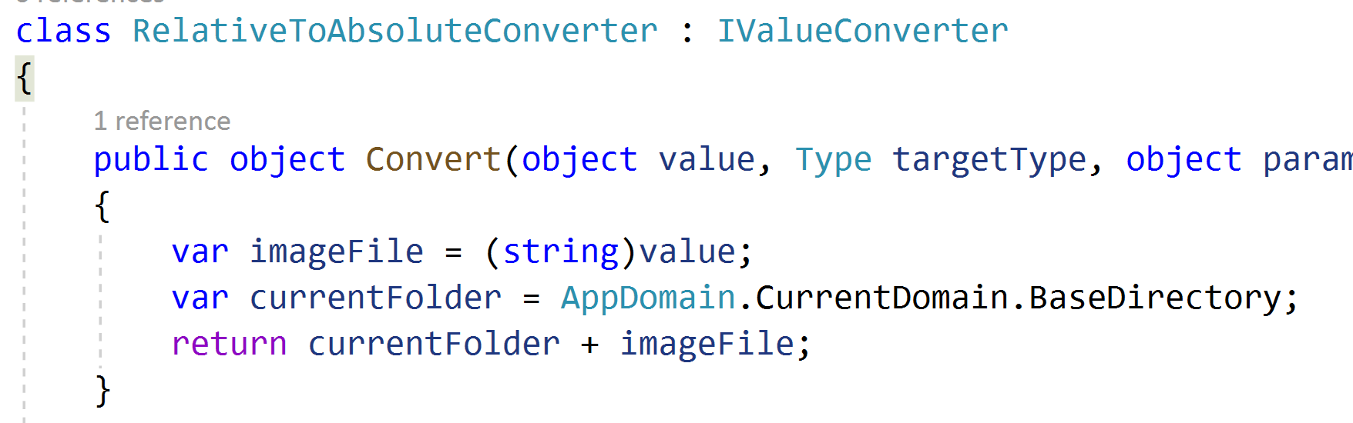
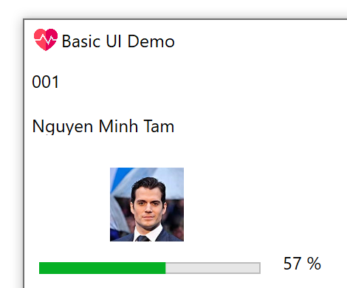
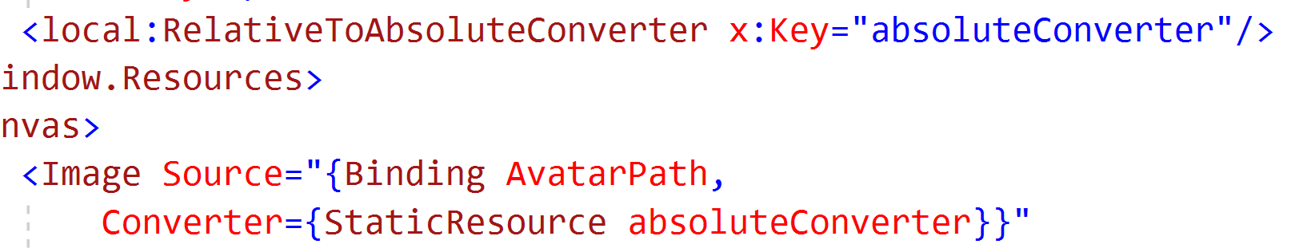
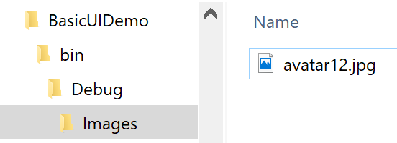
Using absolute path

Slide 15
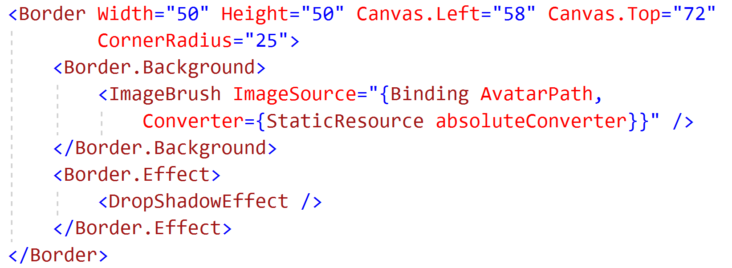

Bonus: Add rounded corner

Slide 16
UI Synchronization

Slide 17
Core idea
Underlying data change => UI automatically change

Slide 18
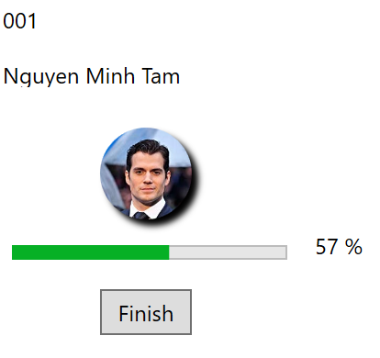
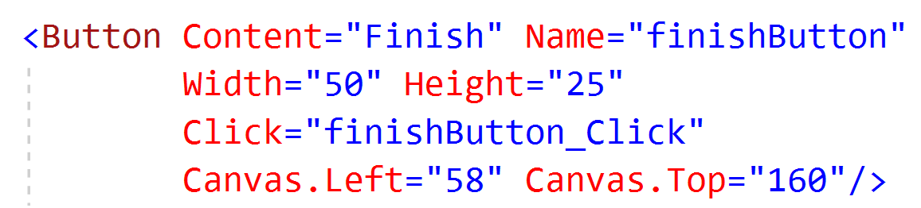
Adding button to update

Slide 19
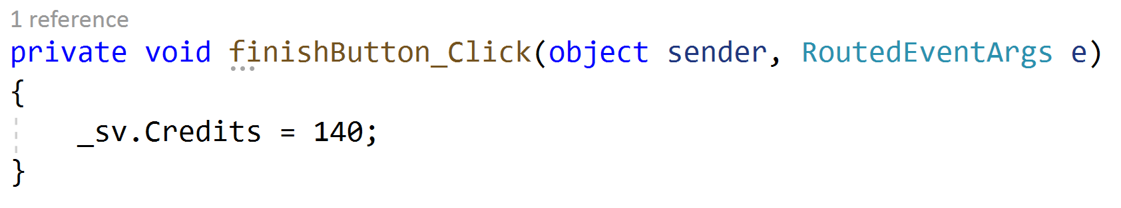
Update the credits when clicked
We see nothing change in the UI! Why?
Need to implement INotifyPropertyChanged

Slide 20
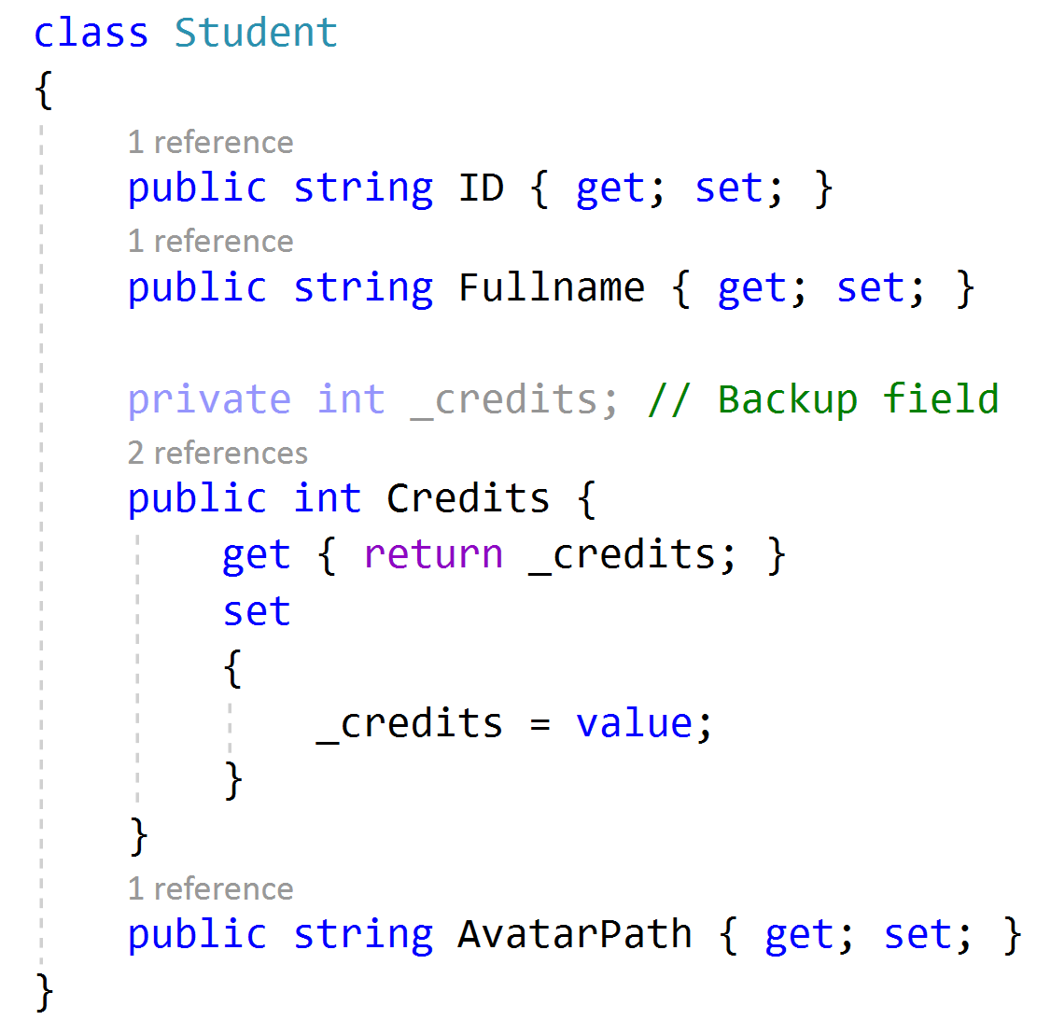
Underlying code of getter and setter

Slide 21
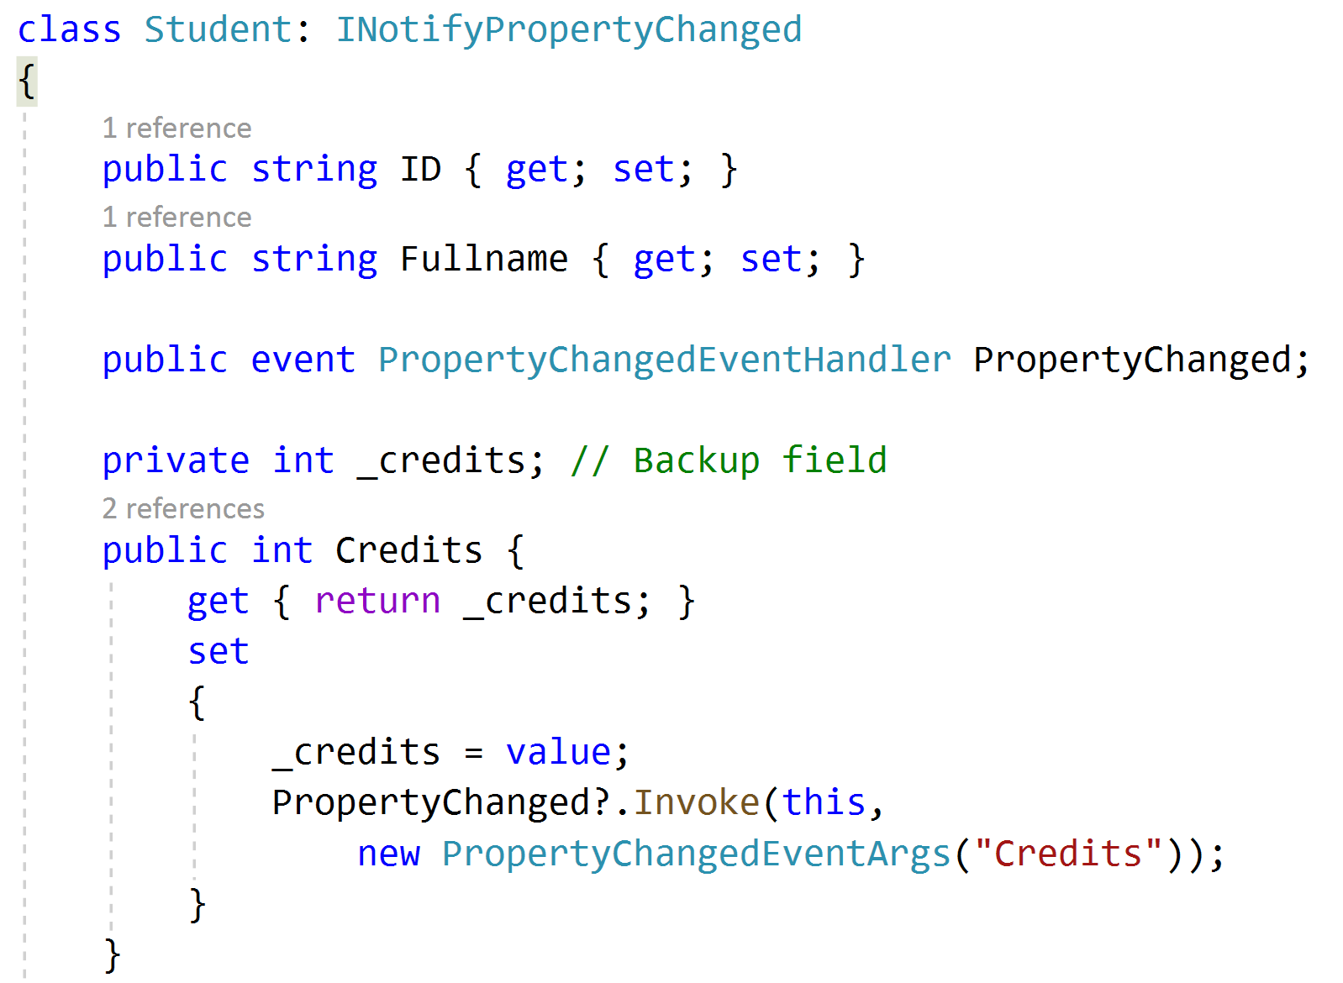
Implementing INotifyPropertyChanged

Slide 22
Tools to use rather than manually writing
PropertyChanged.Fody (Need at least VS 2019)
Weaving: injecting functionality into an existing program
Source code: inject source code lines before the code is compiled
IL weaving (for .NET) adds the code as IL instructions in the assembly
ByteCode weaving (for Java) works on the class file

Slide 23
Exercises
Do data binding for a book: Book’s name, Cover’s image, Author, Published Year, ISBN
Do data binding for a mobile phone: Phone’s name, Image, Manufacturer, Price
Do data binding for an employee: Fullname, Email, Address, Telephone number, Avatar’s image

Slide 24
Binding a list

Slide 25
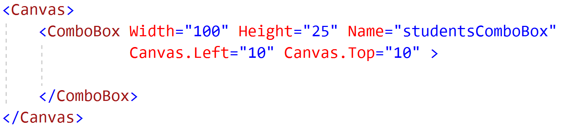
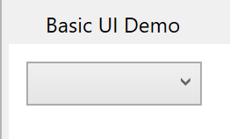
Prepare UI using ComboBox

Slide 26
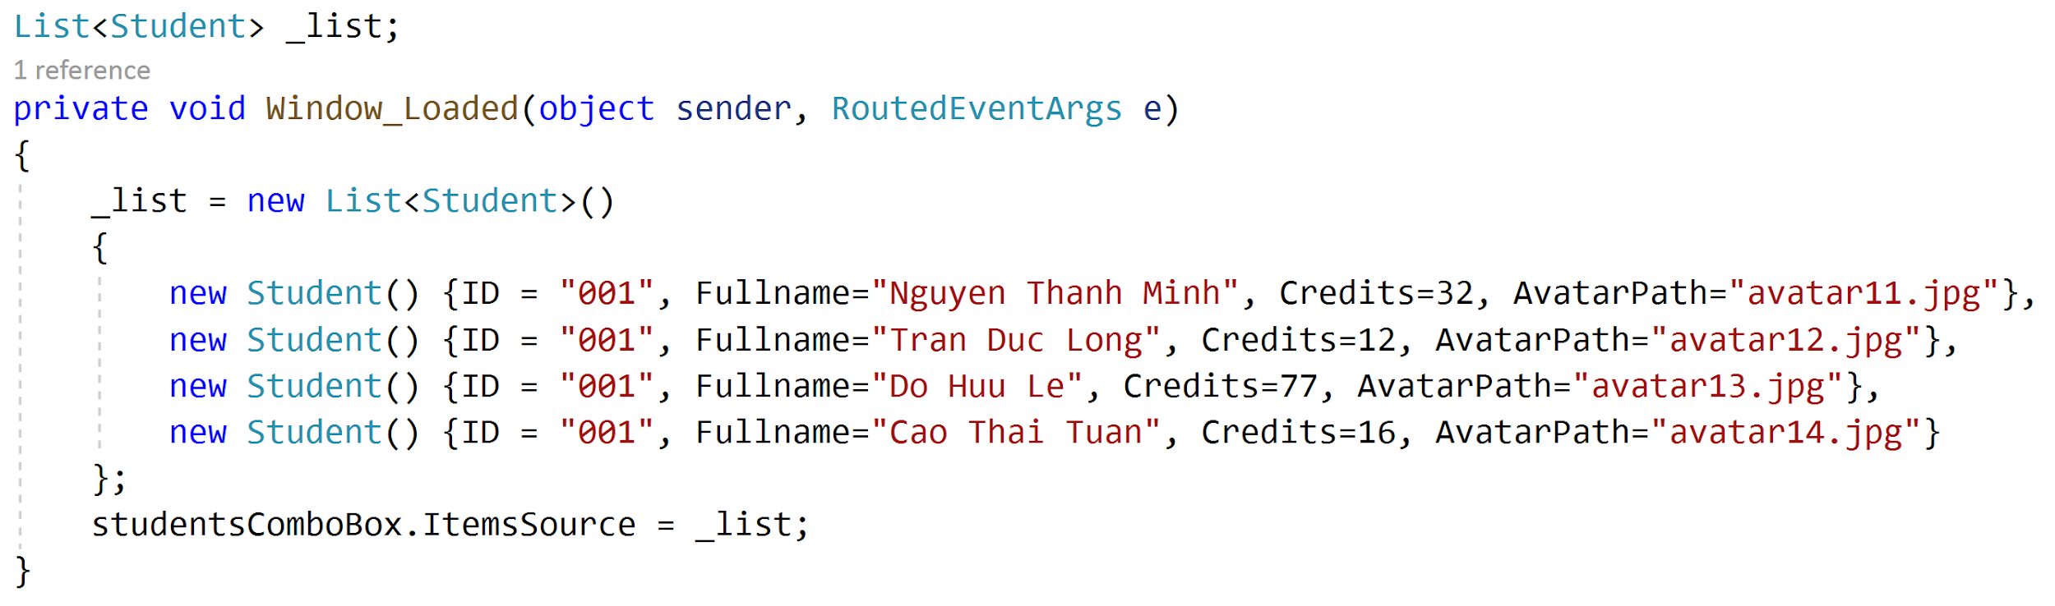
Sample data
Notes:
_students = new ObservableCollection<Student>()
{
new Student() {
ID = "001",
Name="Ngư Thuận Phong",
Avatar="Images/avatar01.jpg"
},
new Student() {
ID = "002",
Name="Mai Việt Hùng",
Avatar="Images/avatar02.jpg"
},
new Student() {
ID = "003",
Name="Thủy Tất Hiếu",
Avatar="Images/avatar03.jpg"
},
new Student() {
ID = "004",
Name="Nguyễn Trí Dũng",
Avatar="Images/avatar04.jpg"
},
new Student() {
ID = "005",
Name="Hồ Hồng Quang",
Avatar="Images/avatar05.jpg"
},
new Student() {
ID = "006",
Name="Vũ Tuấn Hùng",
Avatar="Images/avatar06.jpg"
},
new Student() {
ID = "007",
Name="Nguyễn Việt Cường",
Avatar="Images/avatar07.jpg"
},
new Student() {
ID = "008",
Name="Lâm Thanh Toàn",
Avatar="Images/avatar08.jpg"
},
new Student() {
ID = "009",
Name="Trịnh Việt Nhân",
Avatar="Images/avatar09.jpg"
},
new Student() {
ID = "010",
Name="Bùi Ðức Cường",
Avatar="Images/avatar10.jpg"
},
new Student() {
ID = "011",
Name="Phan Thiện Dũng",
Avatar="Images/avatar11.jpg"
},
new Student() {
ID = "012",
Name="Phan Nhật Quân",
Avatar="Images/avatar12.jpg"
},
new Student() {
ID = "013",
Name="Ngô Việt Dũng",
Avatar="Images/avatar13.jpg"
},
new Student() {
ID = "014",
Name="Hoàng Vinh Quốc",
Avatar="Images/avatar14.jpg"
},
new Student() {
ID = "015",
Name="Đặng Ðức Siêu",
Avatar="Images/avatar15.jpg"
},
new Student() {
ID = "016",
Name="Đàm Thanh Thanh",
Avatar="Images/avatar16.jpg"
},
new Student() {
ID = "017",
Name="Lục Phương Loan",
Avatar="Images/avatar17.jpg"
},
new Student() {
ID = "018",
Name="Uất Như Quỳnh",
Avatar="Images/avatar18.jpg"
},
new Student() {
ID = "019",
Name="Lạc Huyền Trân",
Avatar="Images/avatar19.jpg"
},
new Student() {
ID = "020",
Name="Nguyễn Băng Băng",
Avatar="Images/avatar20.jpg"
}
};

Slide 27
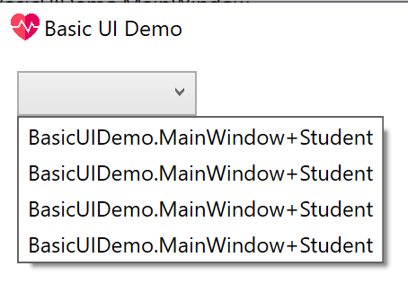
The result

Slide 28
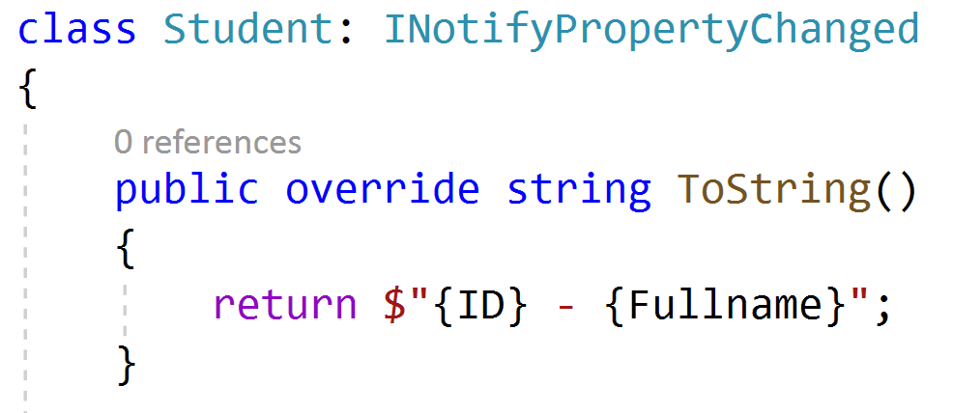
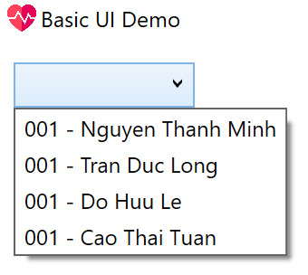
Simple way to modify
But it should not be this way, why?
Because this class’s job is not displaying data

Slide 29
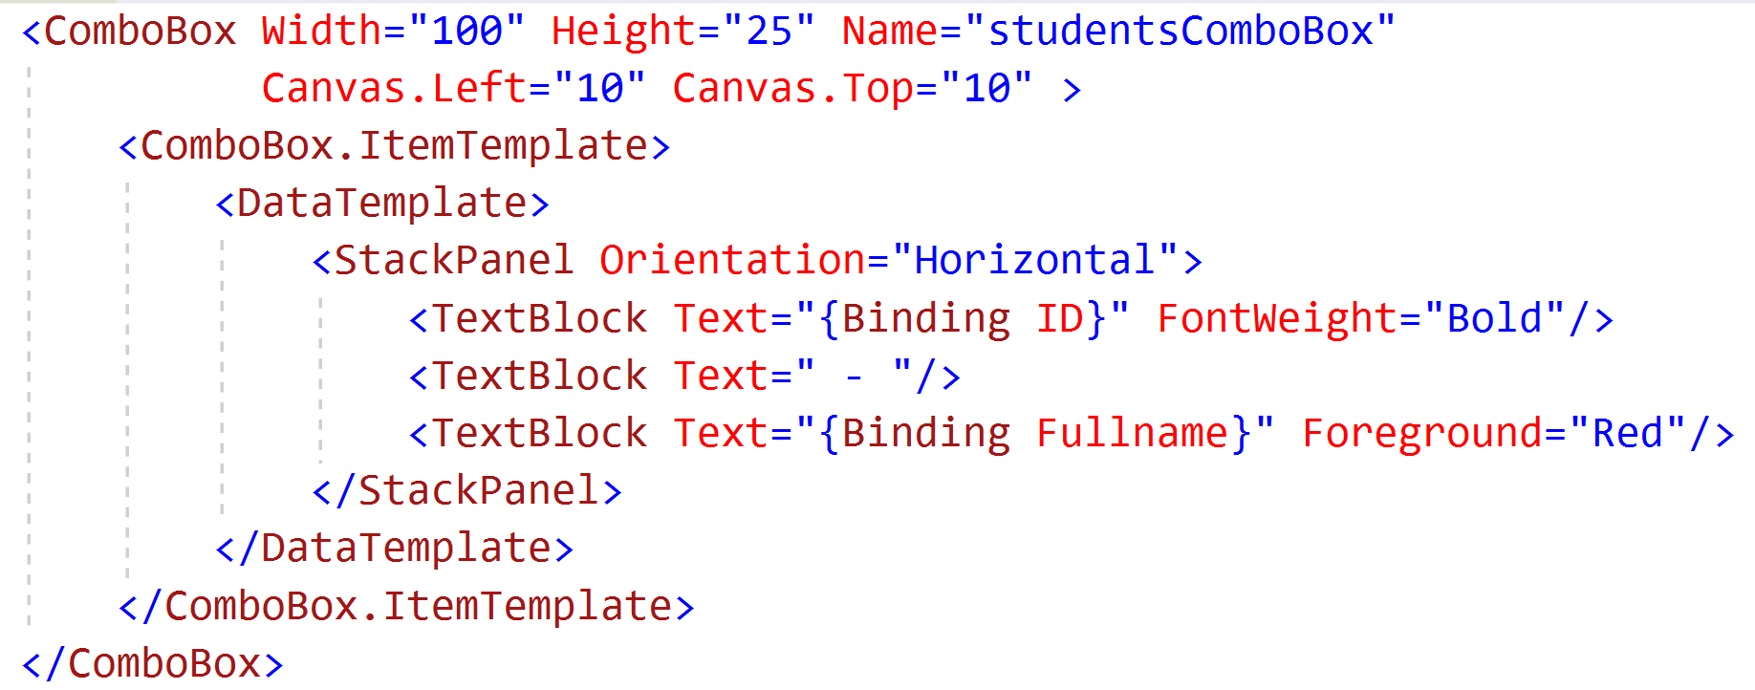
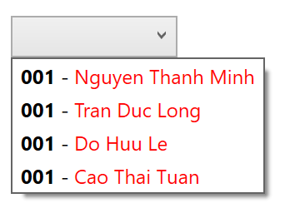
Using ItemTemplate

Slide 30
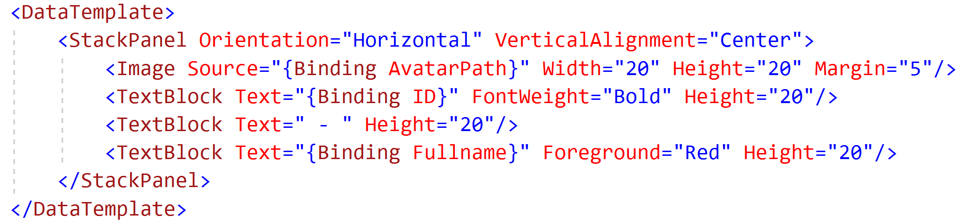
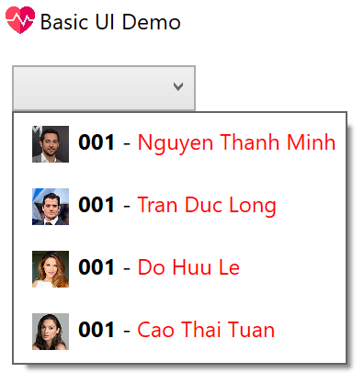
Adding image

Slide 31
Editing the list

Slide 32
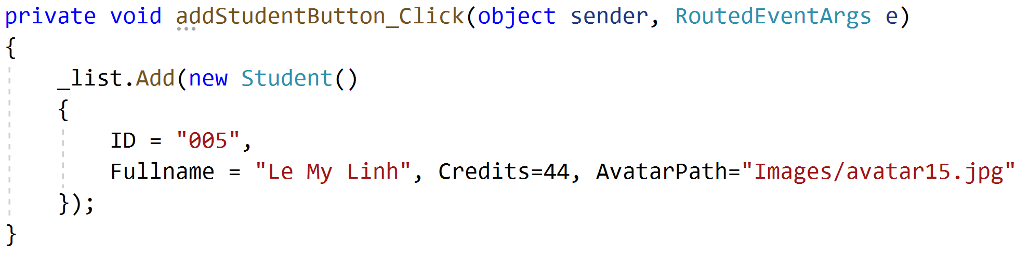
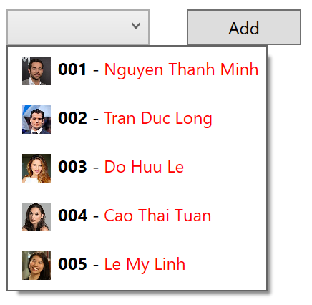
Adding a new item
Convert the list to BindingList

Slide 33
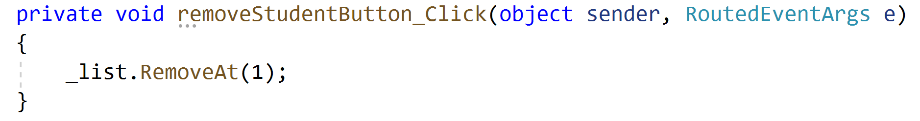
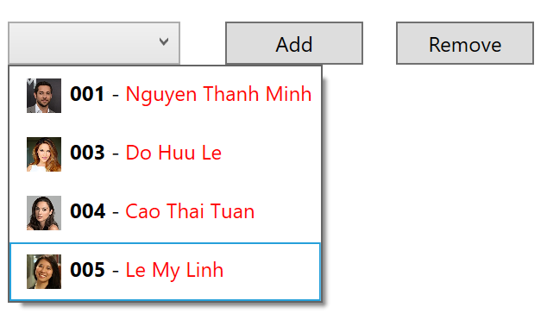
2. Delete an item based on index

Slide 34

3. Deleting an item - The other way

Slide 35
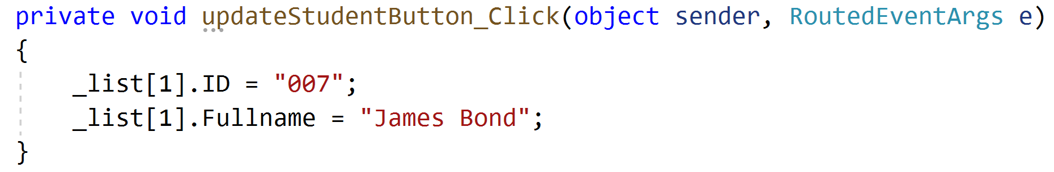
4. Update an item

Slide 36
Using ListView

Slide 37
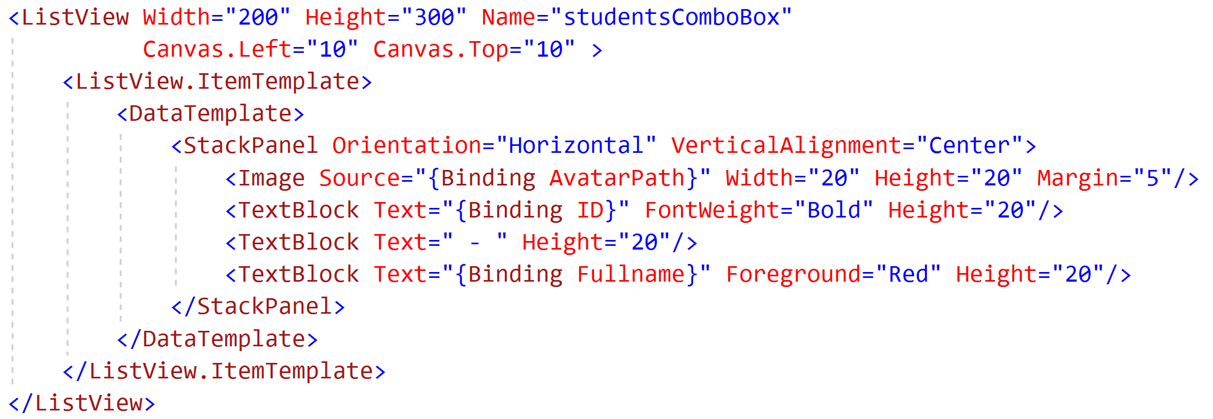
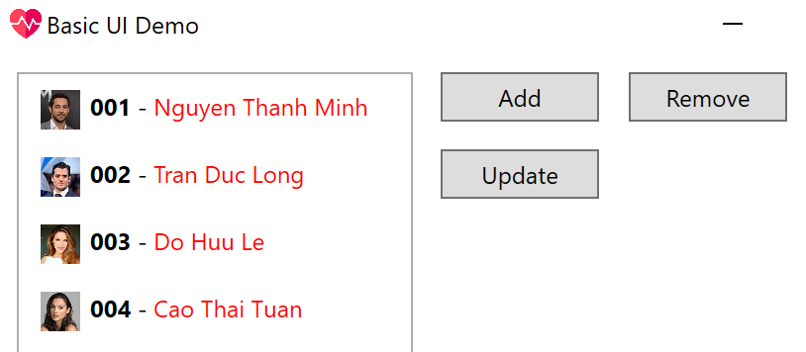
Convert to using ListView

Slide 38
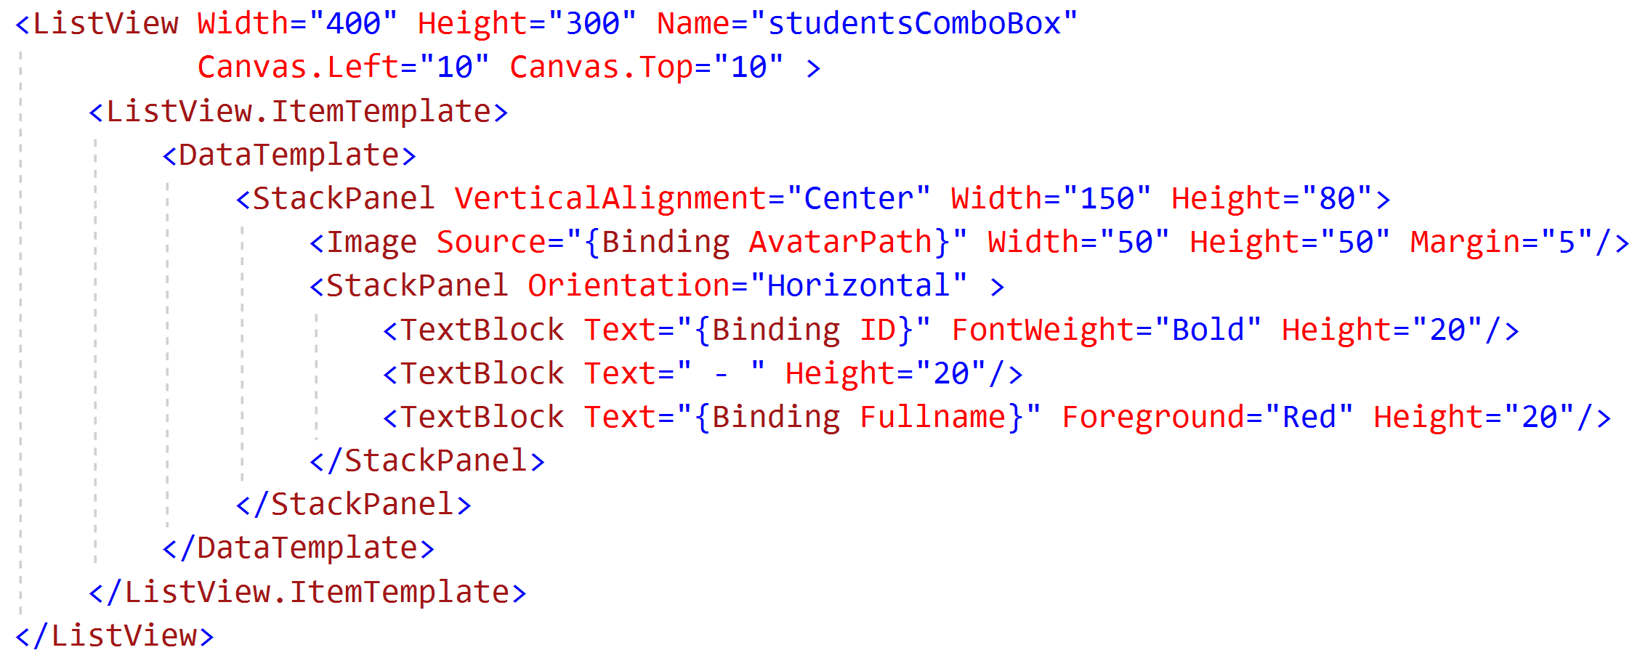
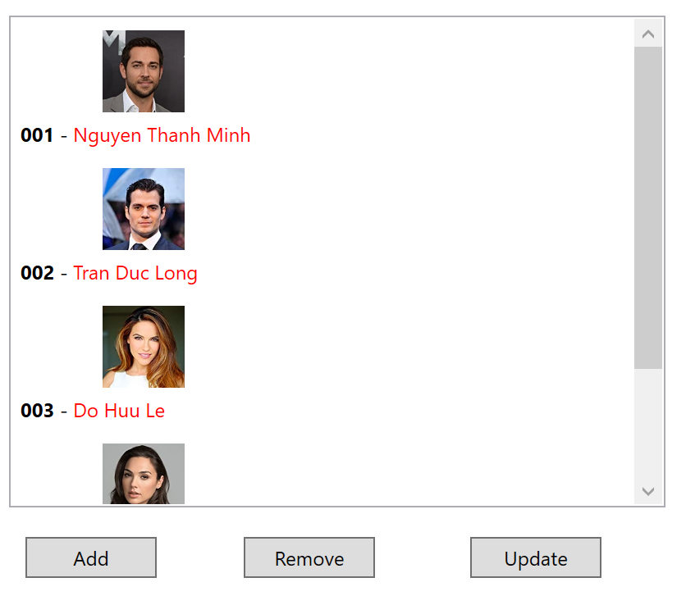
Minor change in displaying

Slide 39
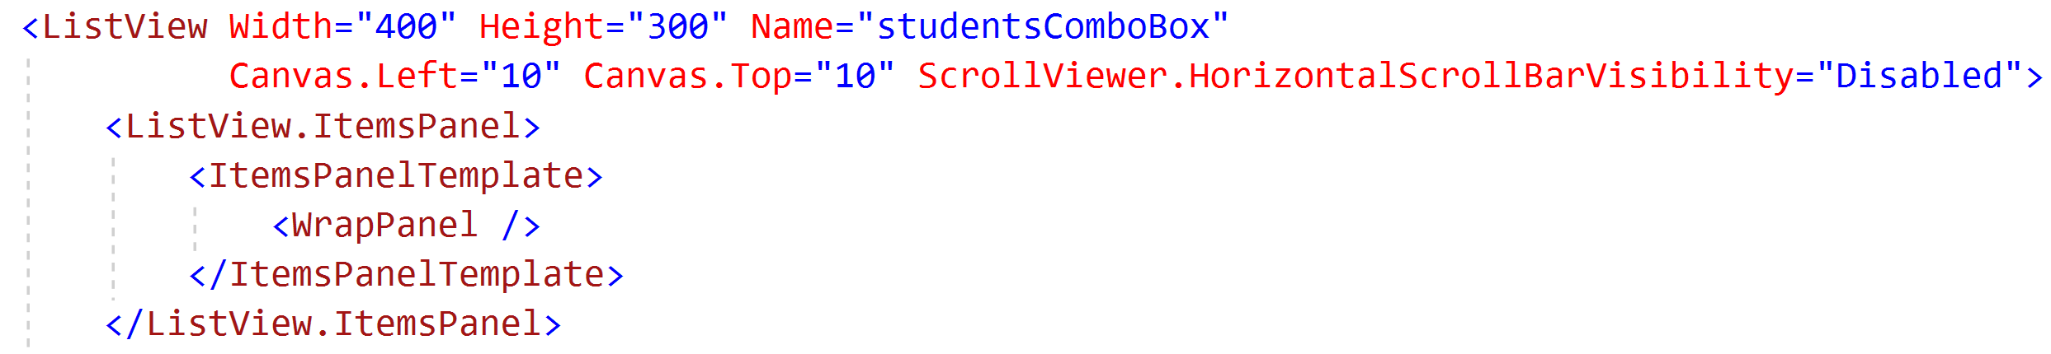
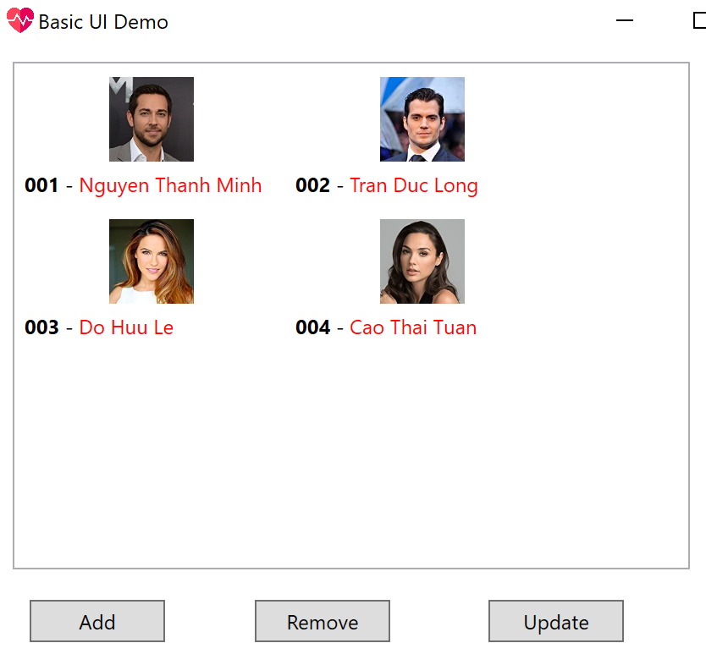
Using WrapPanel / WrapGrid

Slide 40
In class exercises (choose 1 only)
Do data binding for a list of books: Book’s name, Cover’s image, Author, Published Year
Do data binding for a list of mobile phones: Phone’s name, Image, Manufacturer, Price
Do data binding for a list of employees: Fullname, Email, Address, Telephone number, Avatar’s image
Prepare at least 22 items
Add, Delete, Update (hard code data)

Slide 41
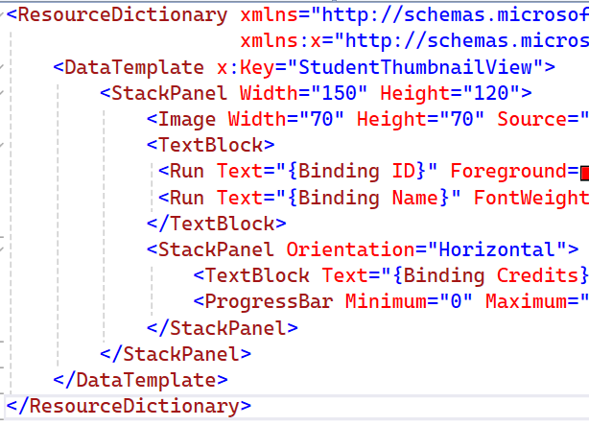
Saving template for reuse - Step 01
Extract data template to a Dictionary.xaml file

Slide 42

Extracting template - Step 02
Merge resource into our Window

Slide 43
Extracting template - Step 03
Specify the template we want to use

Slide 44
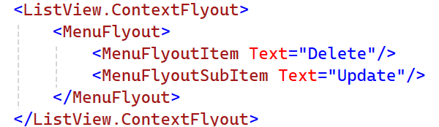
Context menu

Slide 45
Handling context menu (Old)
<ListView.Resources>
<ContextMenu x:Key="TenCuaContextMenu">
<MenuItem Header="Delete" Click="MenuItem_Click"/>
<MenuItem Header="Edit"/>
</ContextMenu>
</ListView.Resources>
<ListView.ItemContainerStyle>
<Style TargetType="{x:Type ListViewItem}" >
<Setter Property="ContextMenu" Value="{StaticResource TenCuaContextMenu}" />
</Style>
</ListView.ItemContainerStyle>

Slide 46
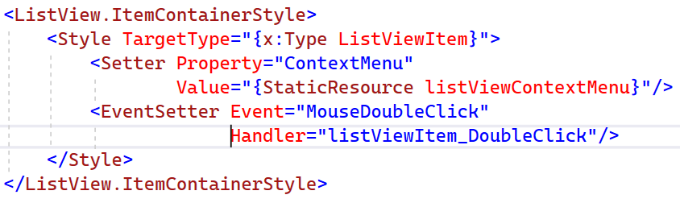
Handling double click
Does not work when clicking on empty space, must set event handler using Style

Slide 47
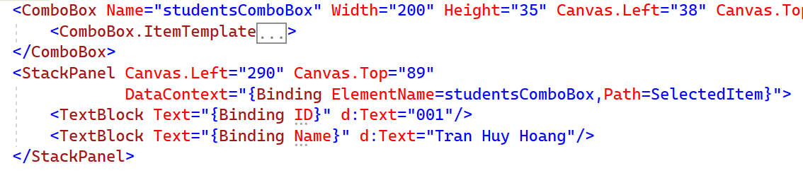
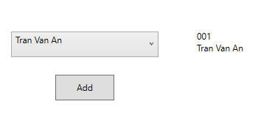
Master-Detail data binding

